Slide 1
Legal Overview
August 2020

Slide 2
Are Inefficient Workflows Impacting Your Legal Business?
Typical law firm processes 1000s of physical documents every year:
Pleadings
Motions
Contracts
Wills
Trusts
Evidence files
Leases
Deposition transcripts
Inefficient legal manual processes impact customer service, creates security risks and results in unrecoverable billable costs.

Slide 3
Benefits of an Automated Document Workflow Solution
Secures and Protects Sensitive Information
A client’s sensitive, confidential, and private information is easily protected. Options like encryption, authentication, and password protection allows law firms to send/receive information safely and securely.
Reduces Costs
Eliminates need to outsource document processing tasks, frees up legal staff to perform other tasks.
Increases Efficiency and Productivity
Finding ways to improve efficiency is critical for law firms to survive. Automated workflows allow attorneys to complete more billable tasks and eliminates inefficiencies.
Improves Customer Service
Lawyers will be able to access information easily to answer any queries related to a client.
Lawyers must use technology to automate their practices' workflows in order to compete in today's rapidly changing legal marketplace

Slide 4
Drive Change with Dispatcher Phoenix’s Legal Solution
With Konica Minolta’s Dispatcher Phoenix, law firms and legal organizations can:
Simplify their document workflow & increase efficiencies
Minimize the need for human intervention in redundant business processes
Maximize productivity & reduce administrative costs
Provide greater process visibility to identify potential bottlenecks
Capture files automatically
Process and route jobs with ease
Distribute in a single step
Dispatcher Phoenix makes creating workflows easy!

Slide 5
Dispatcher Phoenix is…
Award Winning!
Konica Minolta-developed, award-winning automation solution designed to:
Optimize business processes
Reduce costs
Increase productivity
Drive collaboration
Promote growth and innovation
Received the 2021 ‘ASTORS’ Homeland Security Platinum Award for Best Imaging Technology
Selected as BLI’s 2022 Pick for Outstanding Workflow Automation Platform

Slide 6
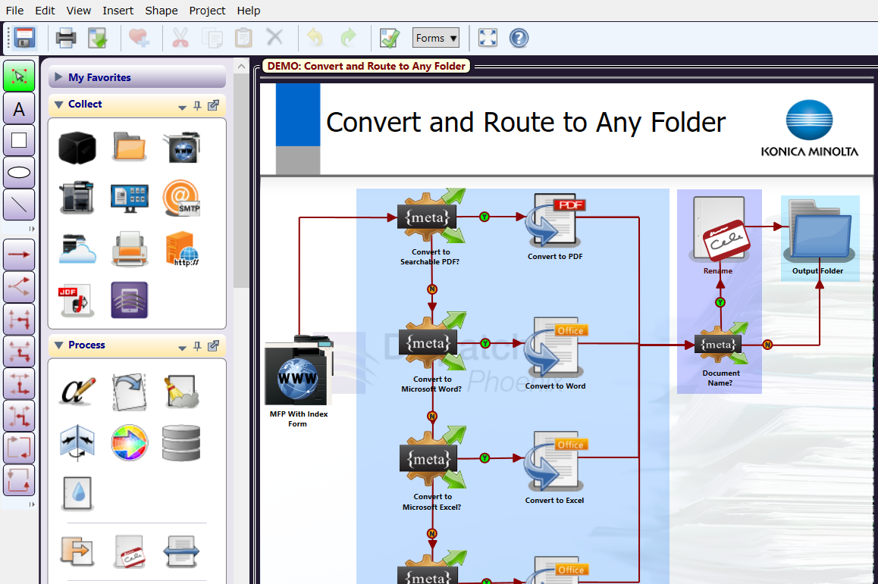
Easily Create and Manage Workflows
Award Winning!
Selected as BLI’s 2020 Pick for Outstanding Workflow Automation Platform
Dispatcher Phoenix’s intuitive Workflow Builder Tool is unique in the market
Allows for advanced, customized workflows to be easily created to suit the specific needs of your customer
Easy-to-use features include:
Graphical icons
Drag-and-drop functionality
Drawing tools
Easy to follow validation messages

Slide 7
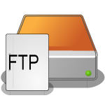
Optimize Workflows with LiveFlo
Displays files being processed through running workflows
Makes it easy to identify bottlenecks
Ensure that inputs, processes and outputs are optimized

Slide 8
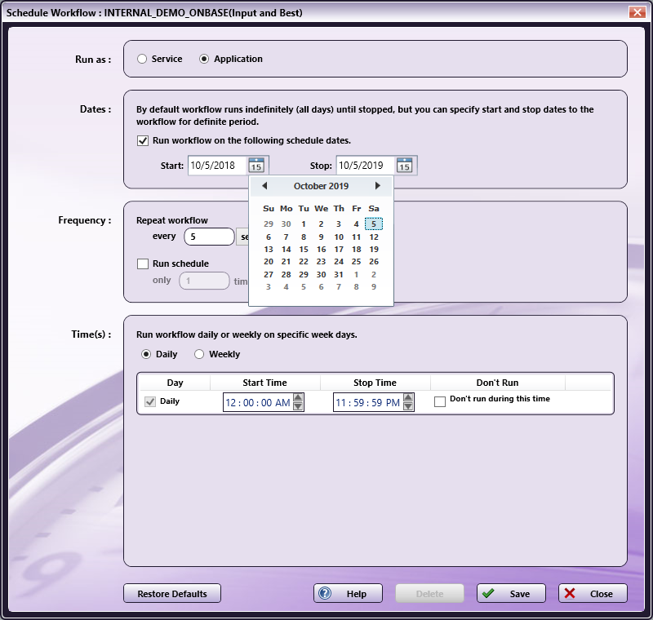
Schedule Workflows to run when you need them!
Award Winning!
Specify a day of the week or time of the day along with a frequency to ensure workflows complete your automation needs when it’s most convenient for the team
Save valuable time and resources by scheduling high-volume, heavy processing workflows after business hours
Schedule workflows to run as a service continually while the PC is on

Slide 9
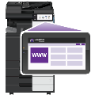
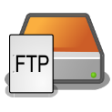
Advanced Capture
Automatically collect documents from a variety of ways for advanced processing, routing, printing, or storing, including:
MFP
Watched Folder
Email Inbox
Mobile Device
Workstation
Web Capture
FTP Server
Dropbox Folder
LPR Print Queue
Etc.

Slide 10
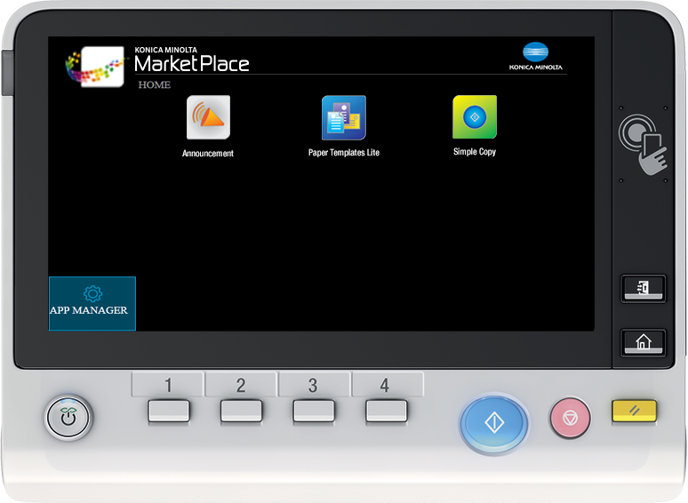
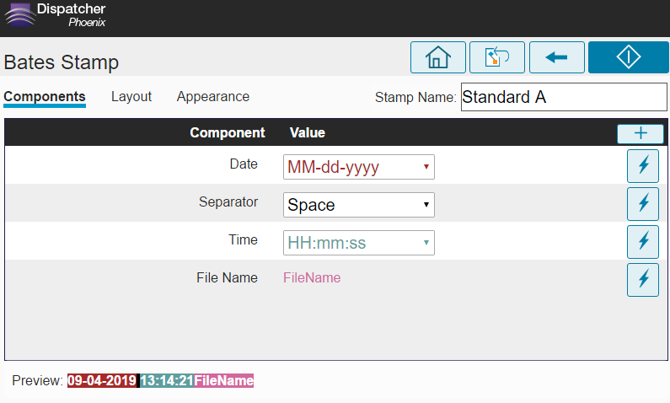
Automated Document Processes
Dispatcher Phoenix supports a variety of document processing tasks from the most simple to more complex including:
Annotation
Watermarking
Rename Files
PDF & Microsoft Office Conversion
Redaction
Highlight & Strikeout
Bates Stamping
Barcode Writing
Zonal Extraction
Forms Processing
Many more…

Slide 11
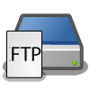
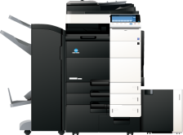
Store Documents In A Single Step
Customize your workflow to send processed documents to a variety of outputs in a single step! Distribution options include:
Folder on the network or Desktop
FTP Server
SFTP Server
Email
Printer
Windows Fax
Production Print Systems
Guardian by LawLogix
OnBase by Hyland
Workshare
Laserfiche
And More…

Slide 12
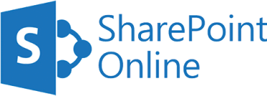
Sharing Documents to Drive Collaboration
Send processed documents to major cloud storage systems
Easy-to-use cloud connectors provide single sign-on to the cloud

Slide 13
Powerful Scalability
With Dispatcher Phoenix’s enhanced scalability, you can create unique, modular, cost-effective solutions tailored to changing business needs. Optional add-in modules include:
Forms Processing
Advanced OCR
Barcode Processing
2D Barcode Processing
Copy Defender
Release2Me for secure print release
Specialized connectors
Much more…

Slide 14
Legal-Specific Use Cases

Slide 15
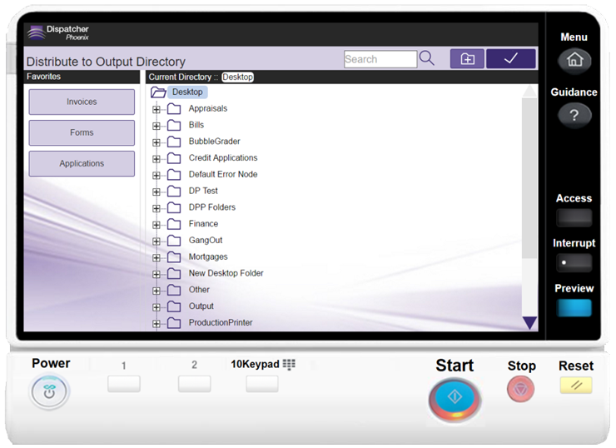
Improved Scanning at the MFP
Improve your efficiencies at the MFP with Dispatcher Phoenix’s intuitive, appealing user interface.
Legal Assistants, staff, and attorneys can:
Easily select a folder to store case files and other legal documents, using a familiar, Windows-like folder structure at the MFP.
Look for specific client / case folders with type-ahead search ease.
Create new folders “on the fly”.

Slide 16
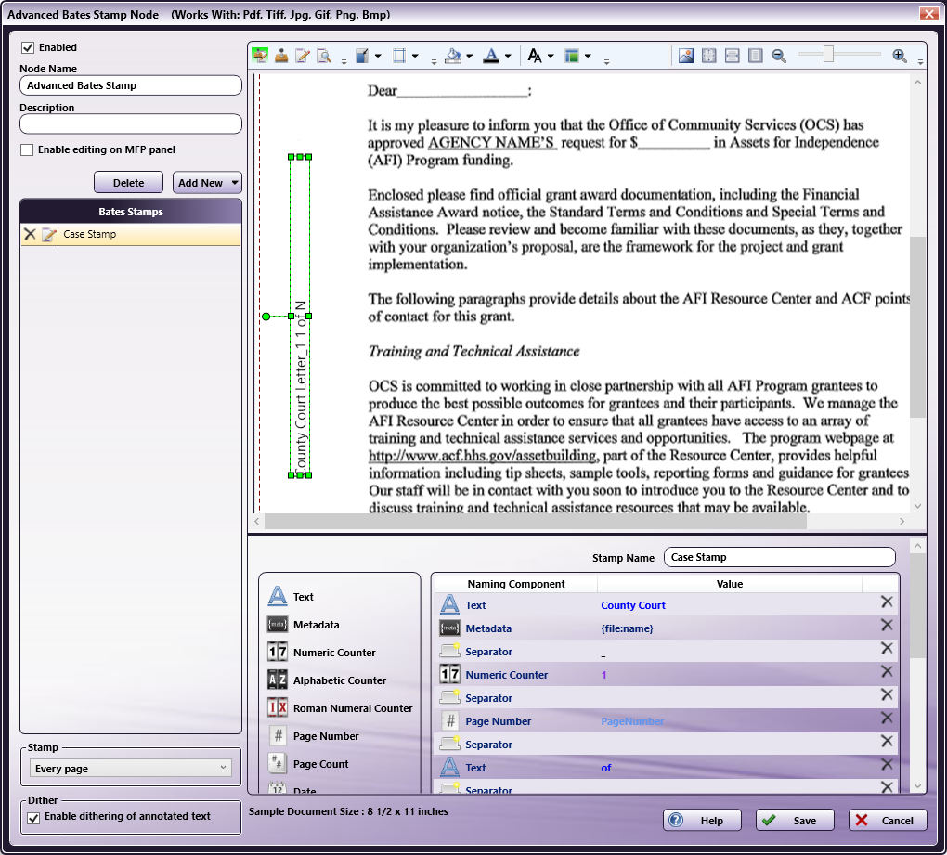
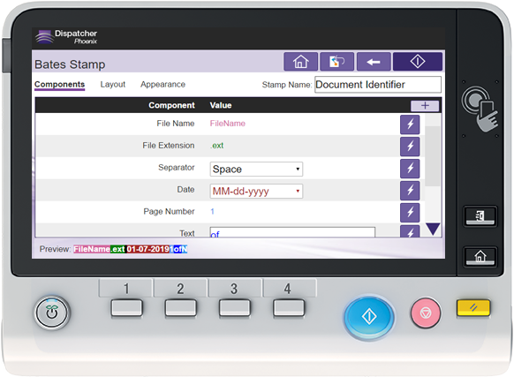
Increased Efficiencies with Advanced Bates Stamping
Instead of legal assistants or temporary staff manually applying Bates stamps on each page of case files, Dispatcher Phoenix can:
Apply unlimited number of stamps anywhere on the page.
Add three different kinds of counters to the stamp, along with metadata, page numbers, static text, etc.
Shrink/shift page content to ensure important content is never obscured.
All Automatically!
Comes with additional flexibility…you can modify, delete, or create Bates stamps directly at the MFP.
Automated Bates stamping saves time, eliminates errors, and reduces labor costs.

Slide 17
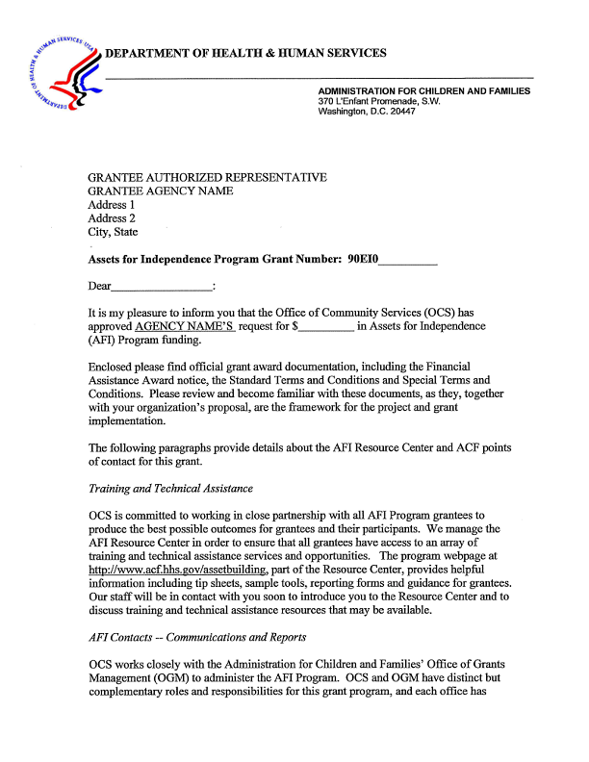
Advanced Bates Stamping Example
Bates stamps can include any configuration of prefix, body, and suffix, without limitations; multiple lines are also supported
Client: ABC
Case: 123 vs. ABC
000000000001
With Dispatcher Phoenix, stamp placement is always ensured. No matter what the document size, the stamp will be placed where you want it
Stamps can include static data, data from the document and other processes, and even auto populating data
Date and Time Received: 08-21-2012 09:00
DRAFT
Stamps can be any color and placed in any orientation (vertical, horizontal, etc.)
Watermarks can identify the nature of the document
Page content can be shifted and shrunk so text is not obscured by stamps
000000000001
Bates stamp’s background can be any color and any size
Bates stamps can be placed anywhere on the page
000000000001
Page 1
Stamp content can be included in different vertical and horizontal orientations
The information contained in this contract has been transcribed using electronic recording devices. As such, certain materials could be modified at a later date.
Text can be highlighted to draw attention to annotations and text itself can be any color

Slide 18
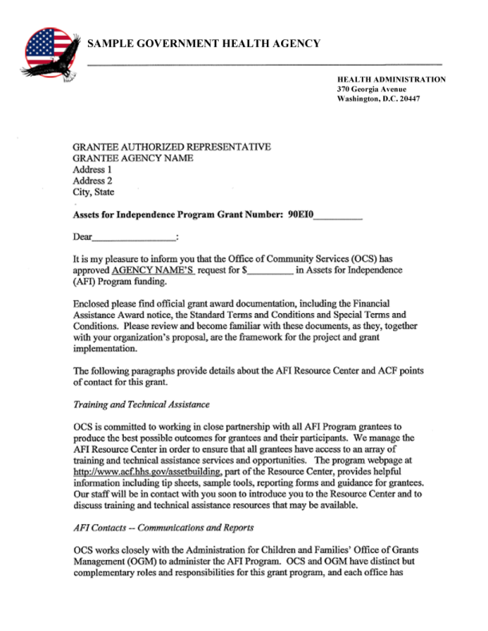
Time Saved with Automatic Highlight & Redaction
Eliminate the need for manual redaction operations using pen or mark-up tape!
Set up a simple search operation to quickly redact, highlight or strikeout sensitive information in case files, affidavits, contracts, etc.
Customize, create or remove document search terms at the MFP Panel.
Redaction permanently removes information from legal documents including case files or agreements

Slide 19
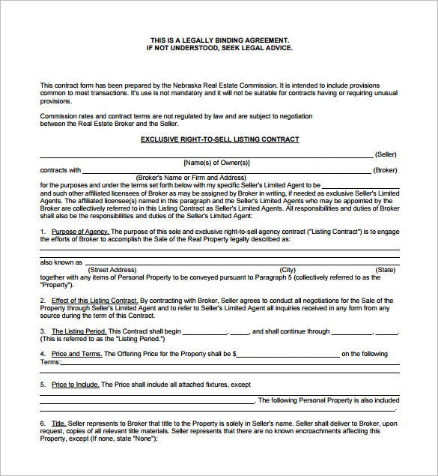
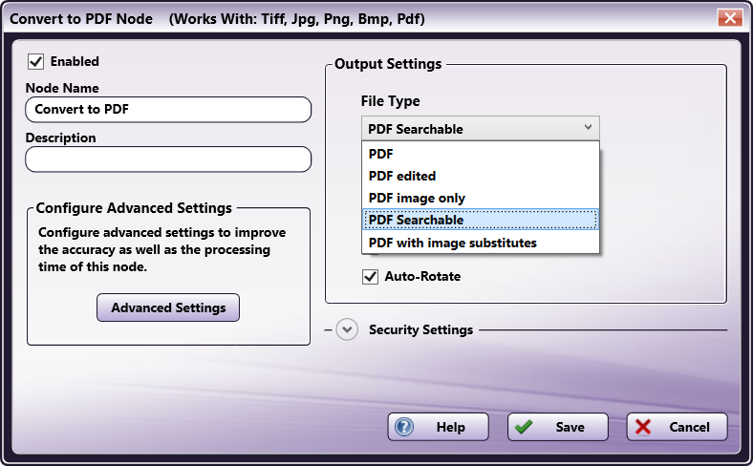
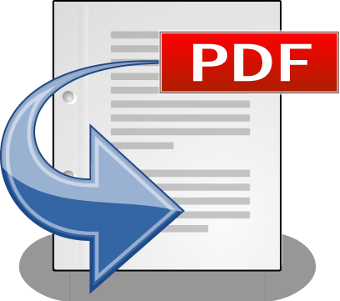
Quick Discovery with PDF Conversion
Maintain the security and integrity of legal documents and case files by automatically converting scanned image files to a variety of PDF formats.
Search, retrieve, view, and print legal documents as needed while keeping originals secure and intact.
Supported PDF formats include PDF Searchable for keyword searching and PDF/A for archiving.

Slide 20
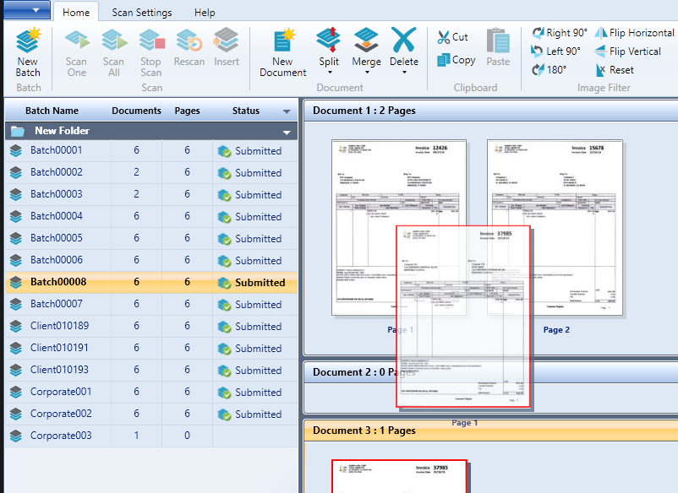
Batch Scan Solution for Records and Case Files
Ideal for law firms that need to manage large amounts of paper documents, Dispatcher Phoenix offers a Desktop Workstation that connects with any 3rd party high-speed scanner. With the Workstation, law firms can take advantage of:
Automated document separation.
Time-saving features, such as rescanning/inserting pages.
Easy-to-use interface for batch verification.
Integration with Dispatcher Phoenix workflows for further batch indexing.

Slide 21
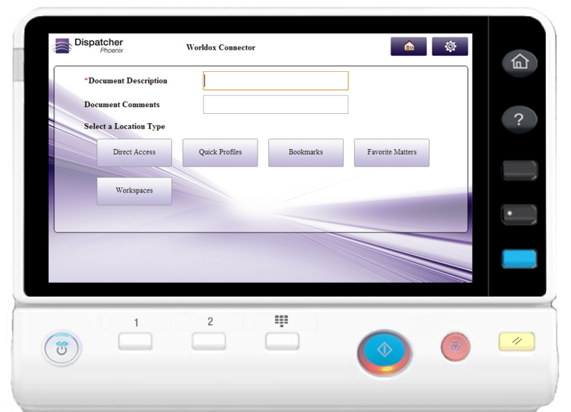
Centralized Information via Worldox Connector
Dispatcher Phoenix’s direct connector to Worldox, a leading document management system for the legal industry, allows legal organizations to scan, process, and store their important client records and case files in Worldox…directly from the MFP!
Additional direct connectors include:
SharePoint
SharePoint Online
Workshare
OnBase
Laserfiche
A variety of cloud storage providers (Box, Dropbox, OneDrive ,Google, etc.)
Much more

Slide 22
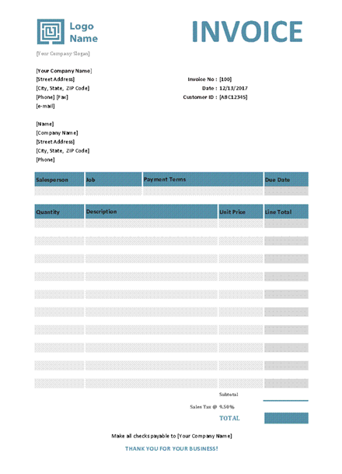
Control Contracts, Invoices, and Other Legal Records
Keep operating costs down while managing an increasing number of legal documents with Dispatcher Phoenix’s intelligent Doc-Classifier.
Doc-Classifier automatically recognizes and identifies a wide variety of document types, including structured, semi-structured and unstructured documents.
Documents can be routed based on type, data can be extracted from certain documents, files can be processed based on metadata, and more…all with a Doc-Classifier workflow.
Doc-Classifier

Slide 23
Additional Automation to Streamline Workflows
Reduce costs with Dispatcher Phoenix advanced routing workflows, automatically sending print jobs to the most appropriate printer via Color Route and Page Count Route.
Comply with e-filing requirements by automatically splitting files for secure, efficient, and effective file handling.
Automatically apply a Confidential watermark and rename documents as part of the workflow.

Slide 24
Resources

Slide 25
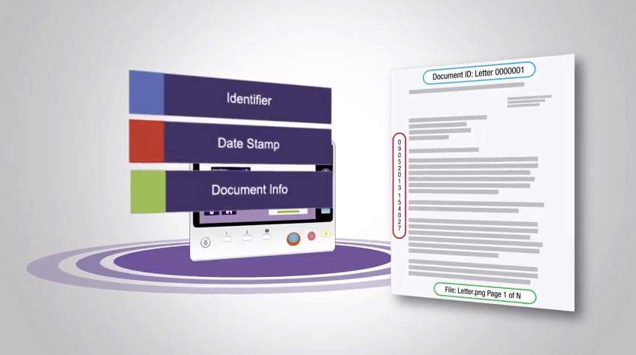
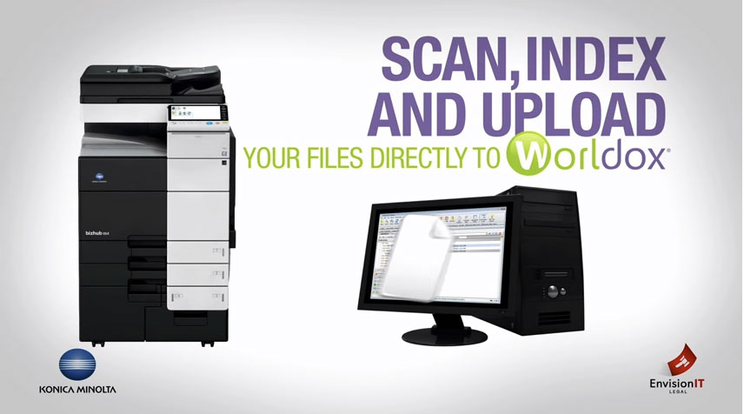
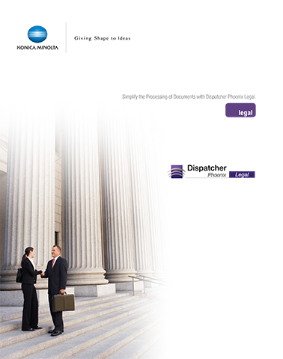
What’s Available for You
Demo Licenses
Fully-functional 30-day demo licenses
NFR licenses for KM sales/support
Marketing
Legal Brochure
Videos
Case Studies
Sample Workflows
Route to Microsoft SharePoint
Redact and Highlight
Annotation
Watermark Blowback
Bates Stamp with Client Info
Bates Stamp Based On Case
Bates Stamp at MFP
Bates Stamp and Highlight
Bates Stamp and Redact

Slide 26
Thank You
sec@kmbs.konicaminolta.us

