Slide 1
Overview
Features & Functions
7/13/12

Slide 2
Need A Document Processing Solution That…
Collects files automatically?
Scans to Word? Scans to Desktop?
Runs workflows on demand?
Distributes documents via email?
Cleans up scanned images?
Watermarks and annotates?
Offers advanced OCR capabilities?
Performs other essential document processing tasks?
All while being one of the industry’s most affordable solutions?

Slide 3
Introducing
Easy-to-use document workflow software
Cost-effective solution for scanning to your Desktop, scanning to Word, and much more
Streamlines document collection, processing, and distribution
Easily expanded with
optional add-in
modules

Slide 4
Simple To Use, Economical, And Powerful
Customized workflows collect, process, and distribute files
Workflows can be scheduled to run, or
Workflows can run on demand with the touch of a button on the MFP

Slide 5
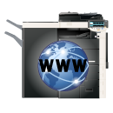
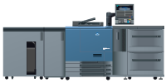
Define Your Inputs…
Files can be collected from:
MFPs running bEST (bizhub Extended Solution Technology)
Local or network folders
User boxes on MFPs
LPR In*
SMTP In*
Printer Port Monitoring*
Multiple inputs in one workflow
LPR Print Driver
Office Printers
Input Folder
bEST
Emails sent from MFP
Production Print
*Optional add-in modules

Slide 6
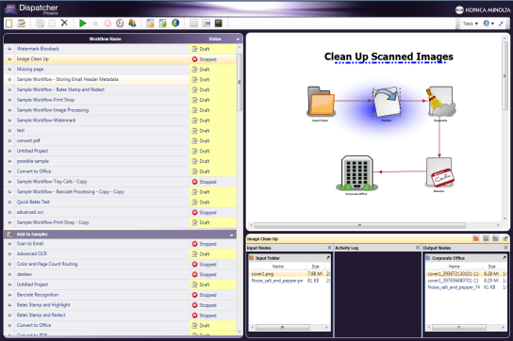
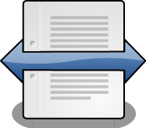
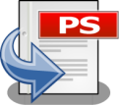
Add A Variety Of Document Processes…
Document imaging processes include:
Annotation
Split
Despeckle
Deskew
Mirror Image
Rename
Negative Image
Watermark
Merge
Convert to
PostScript

Slide 7
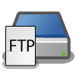
And Distribute Processed Files…
Files can be distributed to:
Output
Folder
Folders
MFPs for printing
FTP servers
Email recipients
And more coming
SMTP
Out
Production Print
Office Printers
FTP
Server

Slide 8
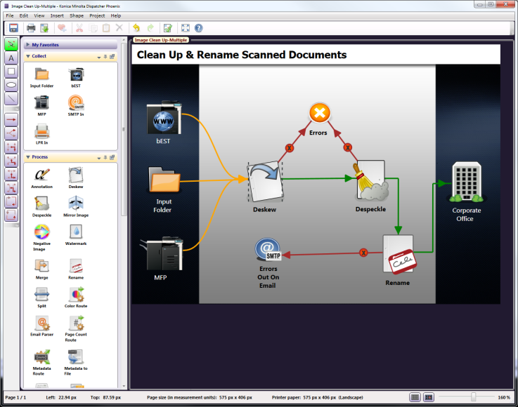
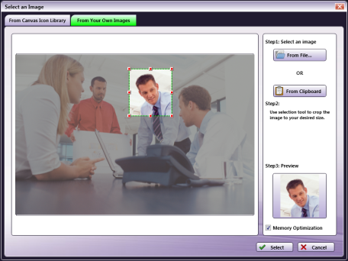
Create Workflows Easily With The Workflow Builder
Graphical and intuitive
Drag-and-drop functionality
Customizable icons
Drawing tools
Multiple connectors
Easy to follow validation messages

Slide 9
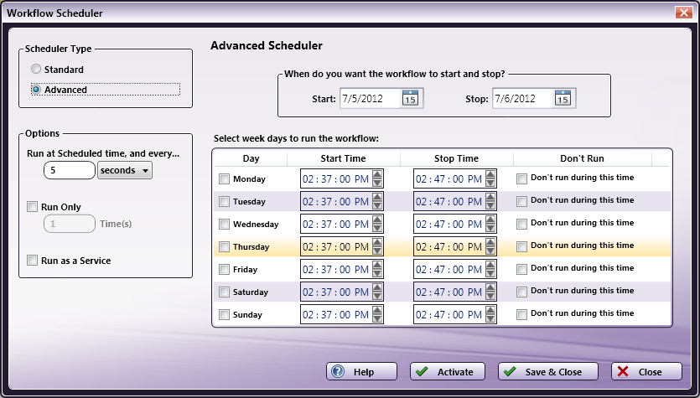
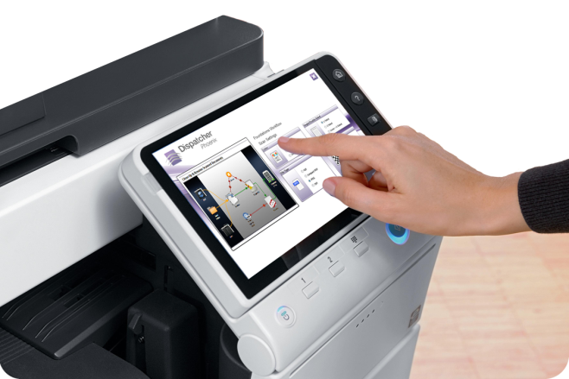
Schedule Your Workflow…
Advanced options included
Specify day and time to run workflows
…Or Start At The MFP Panel
Graphical and Native MFP UI Support
iOption not required for Native UI

Slide 10
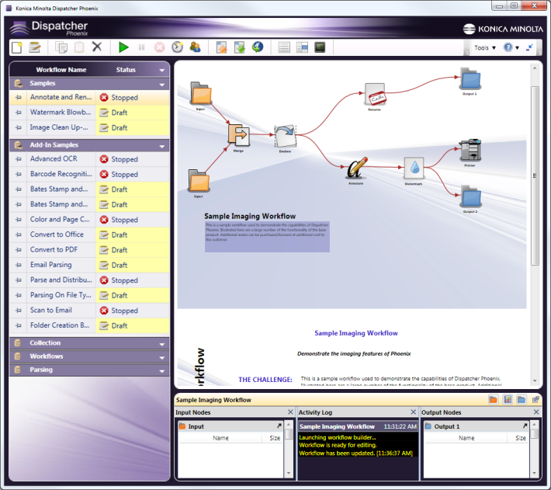
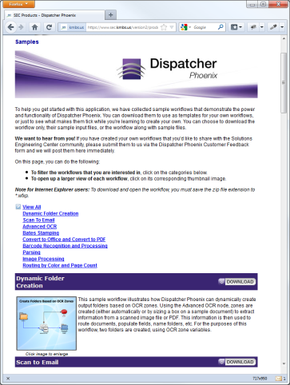
Everything You Need To Get Started Quickly
Fully-configured sample workflow templates include:
Description of use case (challenge, solution, benefits)
Sample input files
Perfect for first-time users
Access to large online library of additional sample workflows to get you started with any task

Slide 11
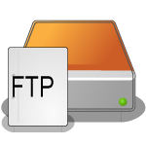
View Running Workflows In Real-Time
Unique LiveFlo technology displays files being processed through running workflows
Makes it easy to identify bottlenecks
Ensure that inputs, processes and outputs are optimized

Slide 12
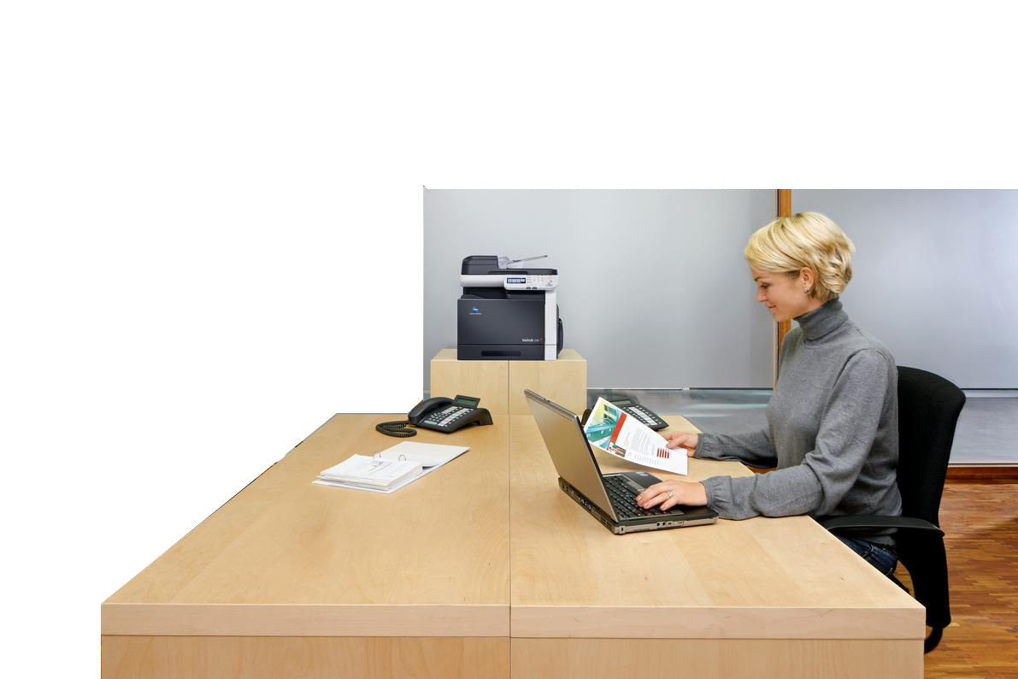
Save Time By Automatically Opening Files At PC
Processed documents can be set to open in the correct application when they arrive at your PC
Example: Dispatcher Phoenix converts scanned documents to Word format and the document
is automatically opened in Microsoft Word on your PC

Slide 13
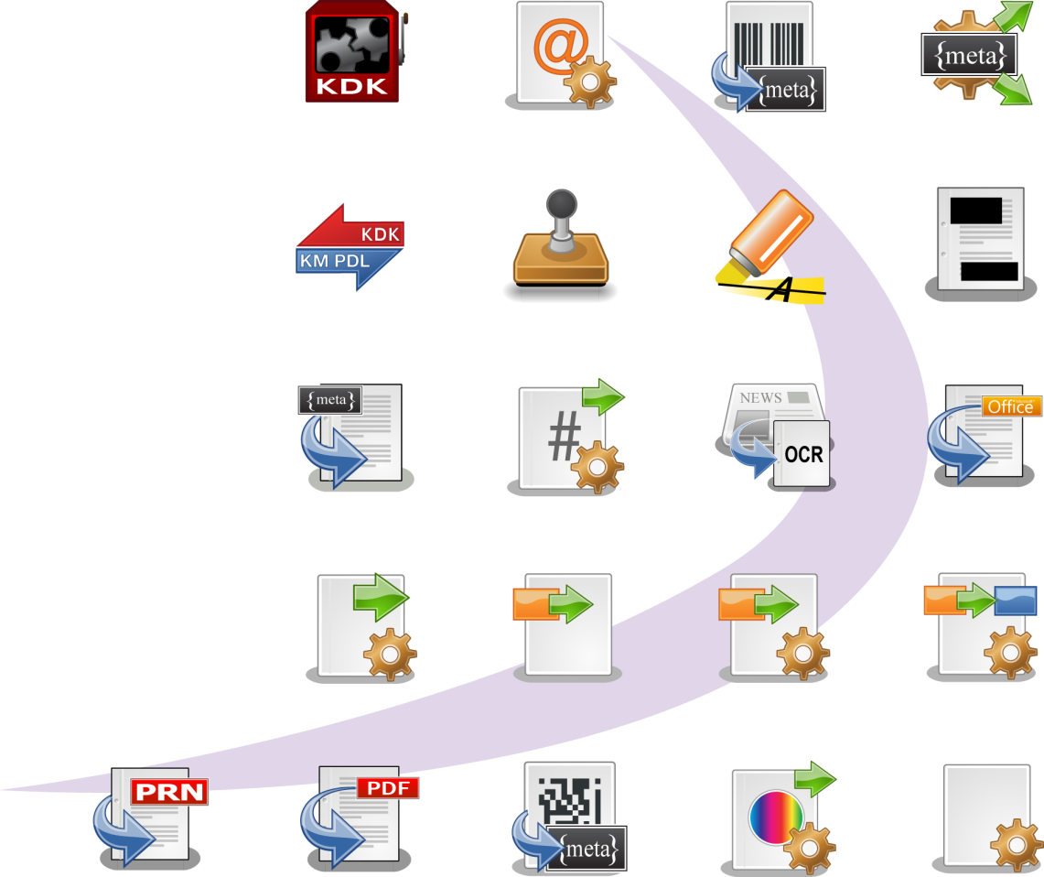
Add Features As Your Needs Change
Optional add-in modules include:
Parsing tool set
Zonal OCR
Convert to PDF and Office
Barcode Processing
Advanced Routing
Metadata Processing
Redaction/Highlighting
Much more…
KDK Code
Generator
Email Parser
Barcode
Processing
Metadata
Processing
KDK-PDL
Converter
Advanced Bates
Stamping
Highlight /
Strikeout
Redact
Metadata to
File
Page Count
Route
Advanced OCR
Convert to
Office
Parse &
Distribute
Insert
Parse &
Insert
Parse &
Replace
Print to
File
Convert to
PDF
2D Barcode
Processing
Color Route
Parser

Slide 14
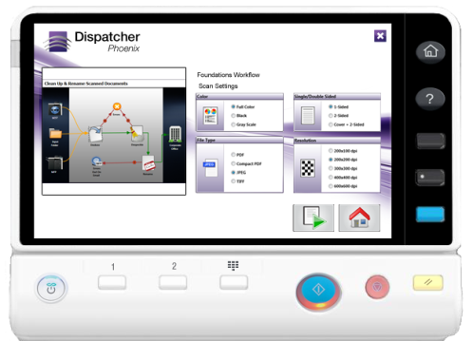
Take Advantage Of This Affordable Solution
Increase your productivity
Reduce labor costs by automating manual tasks
Optimize your business processes with customized workflows
Scalable to grow with your business

Slide 15
Other Dispatcher Phoenix Offerings
Dispatcher Phoenix Professional
Includes all features of Foundations plus extended functionality to integrate with your business processes
File parsing, routing, metadata processing, etc.
Dispatcher Phoenix Legal
Includes all features of Foundations plus advanced capabilities for legal professionals
Bates stamping, PDF file conversion, intelligent redaction, etc.

Slide 16
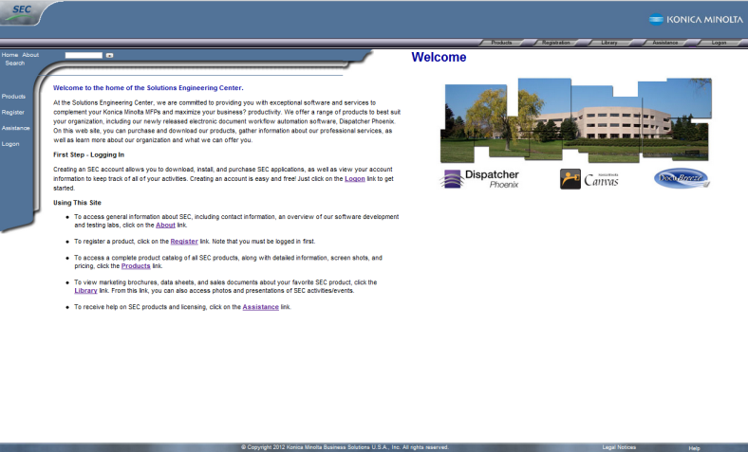
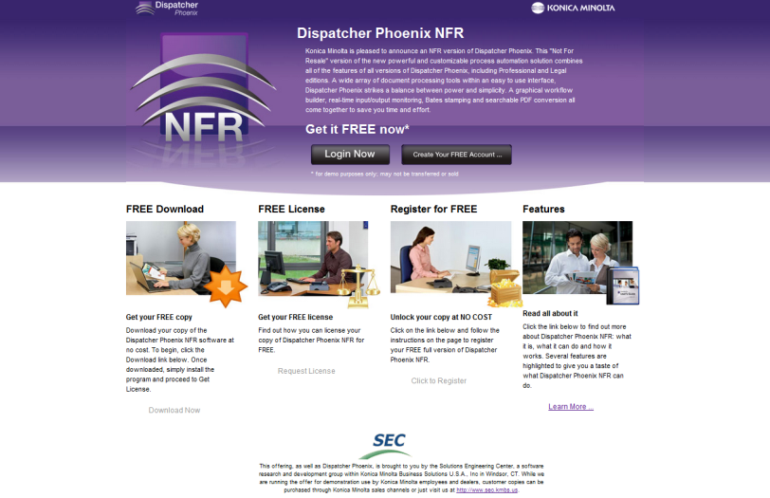
For General Use: 30-day Demo versions are available at the Solutions Engineering Center’s web site: www.sec.kmbs.us
For Konica Minolta Employees and Dealer Sales: NFR available including functionality of all versions of Dispatcher Phoenix: www.sec.kmbs.us/nfr

Slide 17
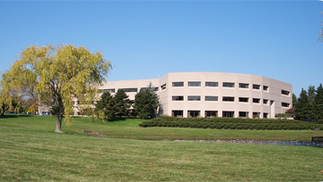
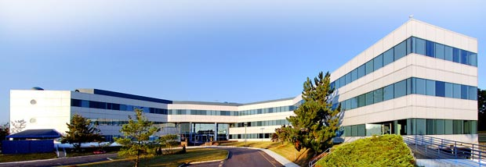
For More Information:
www.kmbs.konicaminolta.us
www.sec.kmbs.us
Product Marketing Manager:
Dean Reonieri
dreonieri@kmbs.konicaminolta.us
Windsor, CT
Ramsey, NJ

