Slide 1
Introducing New Demo Node Licenses
Solutions Engineering Center
January 2019

Slide 2
An award winning automation solution that optimizes business processes, reduces costs, and increases productivity for any organization by:
Automatically collecting files from various locations.
Simplifying scanning/indexing operations at the MFP.
Processing files automatically.
Unique features Include:
Advanced LiveFlo Technology
Simple Graphical Workflow Builder Tool
Intuitive MFP Integration for Document Indexing/Folder Browsing
Direct Connectors to the Cloud, DMS (Box, Dropbox, OneDrive, Google Drive, OnBase, SharePoint, etc.)
Mobile Accessibility for Document Processing & Print Release
Web User Interface for Enterprise Tools & Device Management
Workflow Scheduler
Bubble Grader Solution for educators
Secure Prescription Printing for healthcare professionals
Forms Processing
Much More!

Slide 3
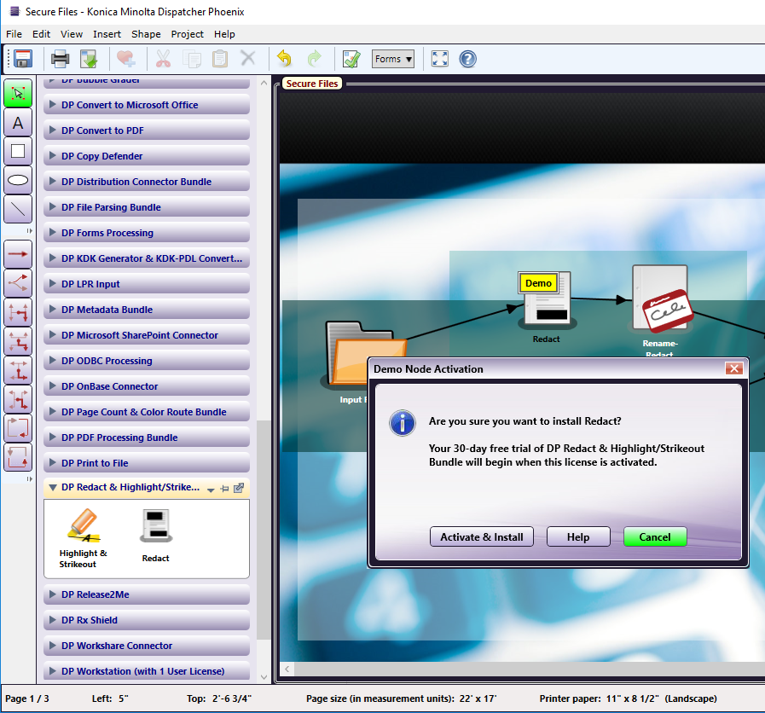
new
Demo Node Licenses
Overview
Demo Licenses now available for ALL Dispatcher Phoenix features:
Along with 30-day Demo Licenses for the entire application, we now support 30 day Demo Licenses for each individual module!
Easy activation right from the Workflow Builder tool
Explore additional DP features for free
Users can now easily activate trial licenses for unlicensed nodes in existing workflows (such as sample workflows)
Notes:
HELP SELL = STRESS
BENEFITS = PREVENTS CONFUSION, ALLOWS CLARITY MOST FREQUENTLY REQUESTED FEATURE
the customer should be able to see all available demo nodes in the existing Workflow Designer node’s pallet. The customer should be able to drag & drop one or more demo node onto the Canvas to initiate the automatic activation and installation of the demo nodes in the corresponding licensable node bundle. The proposed implementation is further explained in detail in the subsequent sections.

Slide 4
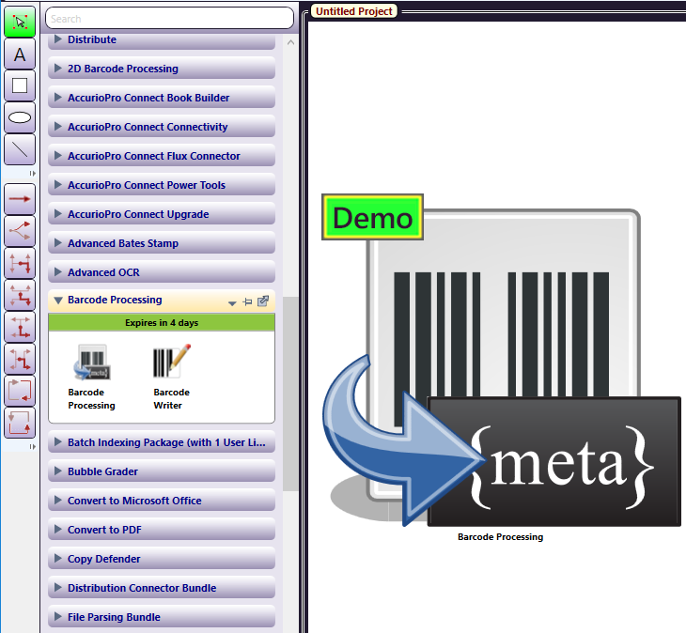
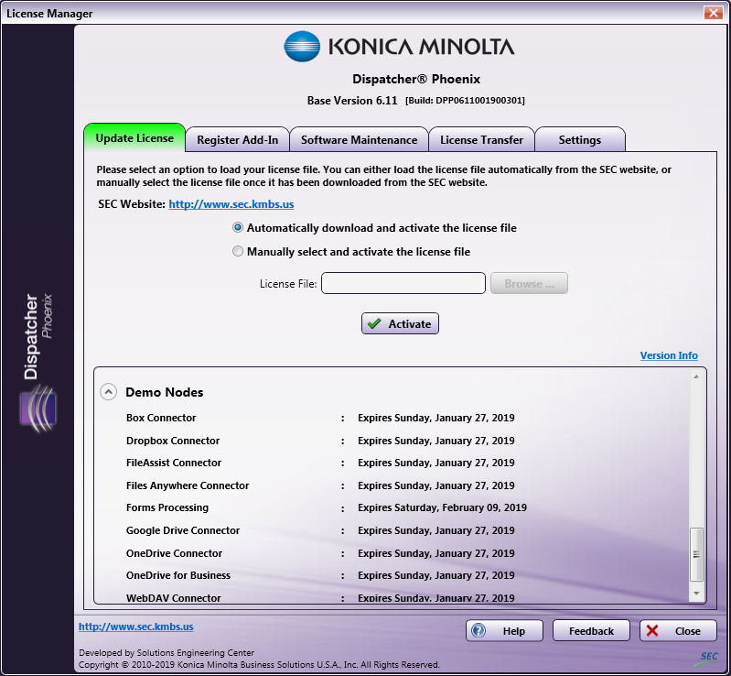
new
Demo Node Licenses
Features
Easily drag-and-drop Demo Node to the workflow canvas to activate the trial license
Comes with free maintenance
Customers will receive node updates during their 30-day trial
Each node clearly indicates its Demo status
Demo Node licenses are displayed by expiration date in the License Manager
Notes:
HELP SELL = STRESS
BENEFITS = PREVENTS CONFUSION, ALLOWS CLARITY MOST FREQUENTLY REQUESTED FEATURE
the customer should be able to see all available demo nodes in the existing Workflow Designer node’s pallet. The customer should be able to drag & drop one or more demo node onto the Canvas to initiate the automatic activation and installation of the demo nodes in the corresponding licensable node bundle. The proposed implementation is further explained in detail in the subsequent sections.

Slide 5
new
Demo Node Licenses
Benefits
“Extensive studies conducted reveal that demos increase long-term purchasing habits and sales of the average customer”
For the Customer
Get to explore all of Dispatcher Phoenix’s add-in modules for free
Will learn how to solve their business processes further
Can quickly evaluate the effectiveness & potential ROI Dispatcher Phoenix can offer
Demo Nodes offer full functionality
Eliminates any hesitations to buy
Extremely easy to use
https://www.productions-plus.com/blog/marketing/product-demonstration/5-reasons-why-you-need-to-demo/
Notes:
HELP SELL = STRESS
BENEFITS = PREVENTS CONFUSION, ALLOWS CLARITY MOST FREQUENTLY REQUESTED FEATURE”
Free trials sharply reduce the need for aggressive selling: A product or service practically sells itself if prospective customers are able to extensively explore what you’re offering on their own. This means your sales team will have a lighter burden to shoulder and more time available to focus, as we did, on other vital tasks such as uncovering and pursuing new leads.”
Two studies of free trial offers of website subscription services found average sales conversion rates of approximately 75 percent – in other words, roughly three-quarters of the people who signed up for the free trial stayed on as paying customers after the trial period ended.

Slide 6
new
Demo Node Licenses
Benefits
“A study of free trial offers found average sales conversion rates of approximately 75%”
~ J.B. Maverick, QuickBooks Small Business Centre
For the Sales Team:
Increases Sales
Shortened sales cycles
Drives faster purchase decisions
Supports upselling for increasing profits
Reduces the need for aggressive selling – sales team will have a lighter burden to shoulder & more time available to focus on other vital tasks
Encourages customer spending
Notes:
HELP SELL = STRESS
BENEFITS = PREVENTS CONFUSION, ALLOWS CLARITY MOST FREQUENTLY REQUESTED FEATURE”
Free trials sharply reduce the need for aggressive selling: A product or service practically sells itself if prospective customers are able to extensively explore what you’re offering on their own. This means your sales team will have a lighter burden to shoulder and more time available to focus, as we did, on other vital tasks such as uncovering and pursuing new leads.”
Two studies of free trial offers of website subscription services found average sales conversion rates of approximately 75 percent – in other words, roughly three-quarters of the people who signed up for the free trial stayed on as paying customers after the trial period ended.

Slide 7
Thank You

