Slide 1
Dispatcher Phoenix ScanTrip Kickstart Digital Transformation

Slide 2
More Paper Coming In…More Data to Handle
Productivity loss from day-to-day document challenges.
Of all employees collaborate over documents using email.
Of business owners want to be able to access files remotely.
* business.com, https://www.business.com/articles/7-statistics-that-will-make-you-rethink-your-document-management-strategy/

Slide 3
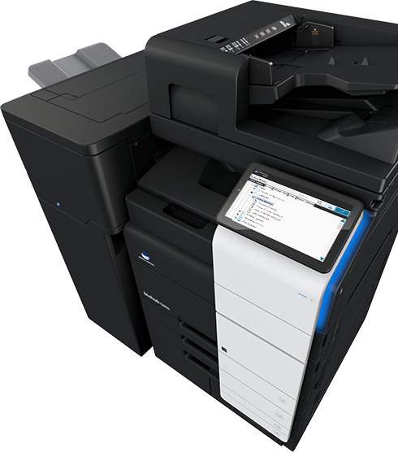
Dispatcher Phoenix ScanTrip Simplifies Scanning
Dispatcher Phoenix ScanTrip provides a simple yet powerful scan solution for handling documents
With this cost-effective, easy-to-use solution, users can easily:
Scan to Me (Support for SMTP and Microsoft Exchange)
Scan to Home
Scan to the Cloud, including Box, Dropbox, OneDrive, OneDrive for Business, Google Drive, SharePoint, SharePoint Online, WebDAV, and more
Scan paper documents from the MFP
Submit electronic files via Web Browser

Slide 4
Advanced Document Processing
Dispatcher Phoenix ScanTrip includes basic zonal OCR support for the Tesseract OCR Engine.
Now with the ScanTrip license you can:
Automate document conversion to Searchable PDF.
OCR scanned documents and extract data.
Dynamically rename documents.
Export index form and OCR metadata.
...at no additional cost!
Rename
Advanced OCR
Metadata to File

Slide 5
Benefits to the Customer
Solution for A Variety of Devices
Powers Digital Transformation
Addresses Paperless Environments
Highly Deployable & Intuitive Solution
Improved Efficiencies & Drives Productivity

Slide 6
Simplified Licensing
ScanTrip is a stackable, standalone license that provides the powerful functionality organizations need for core scanning workflows. With ScanTrip, the following workflows are available:
Scan to Home
Scan to Me
Scan to the Cloud
Dispatcher Phoenix ScanTrip includes a variety of connectors to popular document management systems and cloud storage applications including:
Box
Dropbox
FilesAnywhere
FileAssist
Google Drive
OneDrive
OneDrive for Business
SharePoint
SharePoint Online
WebDAV
ScanTrip Configuration | Processing Nodes | Input & Output Capabilities
Client Application | Rename | MFP Panel
Workflow Builder Tool | Advanced OCR | Web Capture
LiveFlo Technology | Metadata to File | Cloud Connectors
Dispatcher Phoenix Web |  | Output Folder
Workflow Scheduler |  | SMTP Out
Sample Workflows |  | MS Exchange Connector
Integrated MFP Simulator

Slide 7
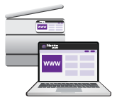
ScanTrip Summary
ScanTrip can be paired with other print management solutions that do not offer scanning capabilities
Ideal solution for customers who:
Are looking to optimize their document digitization journey
Need to streamline file storage to the cloud
Require simple, low cost scanning solution
Any questions? Contact sec@kmbs.konicaminolta.us

