Slide 1
Finance Overview
May 2021

Slide 2
Topics
Overview of Dispatcher Phoenix
Product Overview
Product Key Features
Finance-Specific Features
Finance-Specific Use Cases for Dispatcher Phoenix
Licensing Information
Resources Available For You

Slide 3
How Can Financial Institutions Streamline Their Workflow?
Financial institutions need a workflow solution that is:
Powerful enough to handle any financial services workflow
Easy-to-use and intuitively designed
Full-featured and able to address simple to complex financial services document processing challenges
Expandable as business needs grow

Slide 4
Key Advantages of Automated Finance Workflows
Dispatcher Phoenix is designed to help credit unions, insurance companies, accounting firms, and more maximize efficiency by:
Reducing the manual effort and time needed to process financial documents by leveraging advanced Optical Character Recognition (OCR) and barcode processing
Quickly and accurately extracting, concealing, and/or securing sensitive client information, such as:
Social Security Numbers
Credit card numbers
Business IDs
Tax information
And more!
Seamlessly connecting to the financial processes and ECM systems you already use
Scheduling non-essential and resource-intensive workflows to run during off hours to maximize productivity

Slide 5
Drive Change with Dispatcher Phoenix
With Konica Minolta’s Dispatcher Phoenix, banks, insurance companies, and other financial institutions can:
Streamline document workflow & increase efficiencies
Minimize the need for human intervention in redundant and repetitive business processes
Maximize productivity & reduce administrative costs
Provide greater process visibility to identify potential bottlenecks
Capture files automatically
Process and route jobs with ease
Distribute in a single step

Slide 6
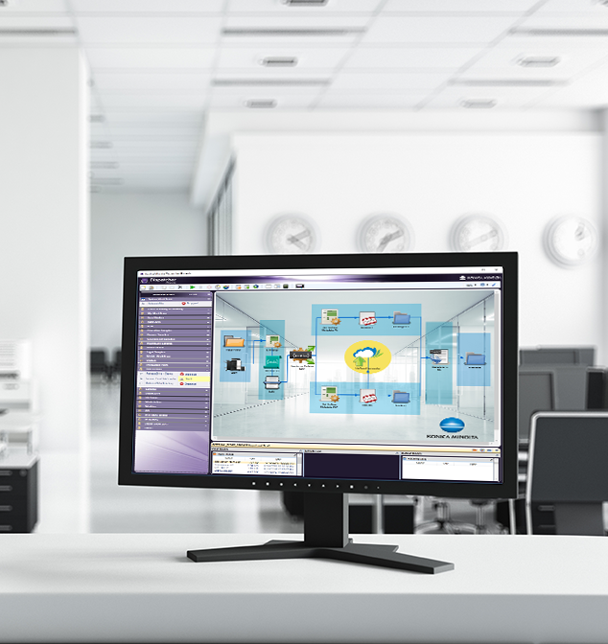
Dispatcher Phoenix is…
Award Winning!
Konica Minolta-developed, award-winning automation solution designed to:
Optimize business processes
Reduce costs
Increase productivity
Drive collaboration
Promote growth and innovation
Received the 2021 ‘ASTORS’ Homeland Security Platinum Award for Best Imaging Technology
Selected as BLI’s 2022 Pick for Outstanding Workflow Automation Platform

Slide 7
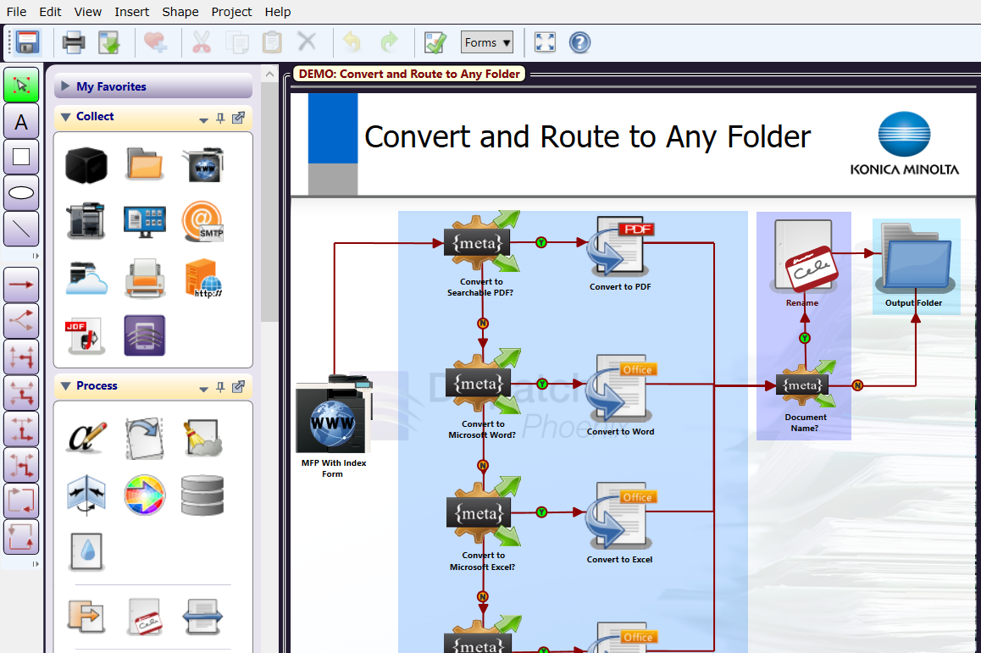
Easily Create and Manage Workflows
Award Winning!
Selected as BLI’s 2020 Pick for Outstanding Workflow Automation Platform
Dispatcher Phoenix’s intuitive Workflow Builder Tool is unique in the market, allowing:
Advanced, customized workflows to be easily created to suit the specific needs of each organization
New users to begin build cost-saving workflows in just minutes
Powerful workflows to be created from scratch or from one of our dozens of pre-built workflows
Easy-to-use features include:
Graphical icons
Drag-and-drop functionality
Drawing tools
Easy to follow validation messages

Slide 8
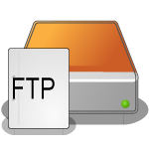
Optimize Workflows with LiveFlo
LiveFlo allows real-time visual observation of documents moving through workflows.
Key features include:
The ability to observe files being processed through running workflows
Easy identification of bottlenecks
Simple optimization of inputs, processes, and outputs

Slide 9
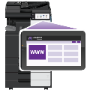
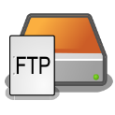
Advanced Capture
Automatically collect documents from a variety of inputs for advanced processing, routing, printing, or storing, including:
MFP
Watched Folder
Email Inbox
Mobile Device
Workstation
Web Capture
FTP Server
Dropbox Folder
LPR Print Queue
Etc.

Slide 10
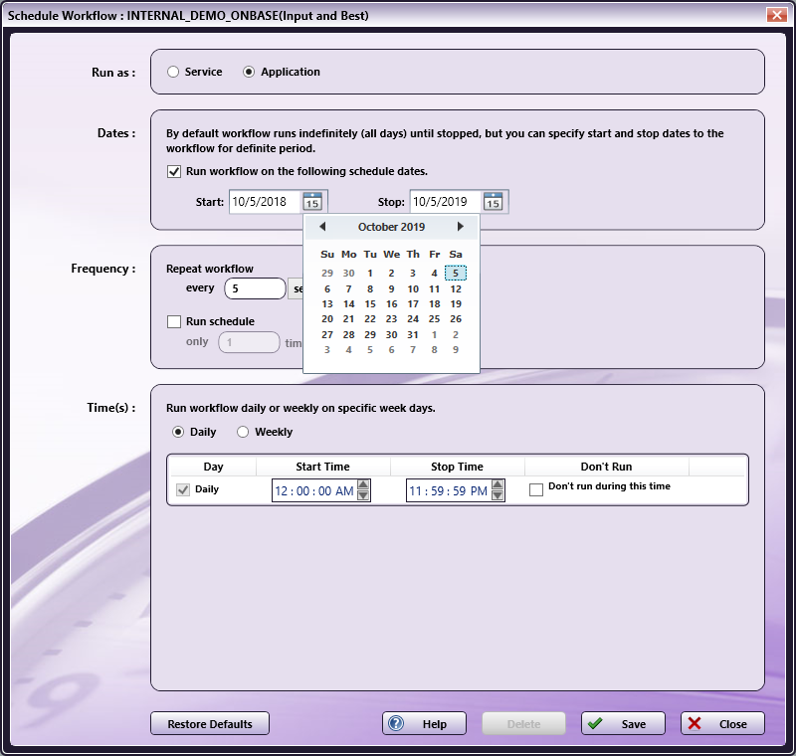
Schedule Workflows to run when you need them!
Award Winning!
Dispatcher Phoenix workflows are highly-customizable and are able to run when they’re most needed. For example, you can:
Specify a day of the week or time of the day, along with a frequency, to ensure workflows complete your automation needs when it’s most convenient for the team
Save valuable time and resources by scheduling high-volume, heavy processing workflows after business hours
Schedule workflows to run as a service continually while the PC is on

Slide 11
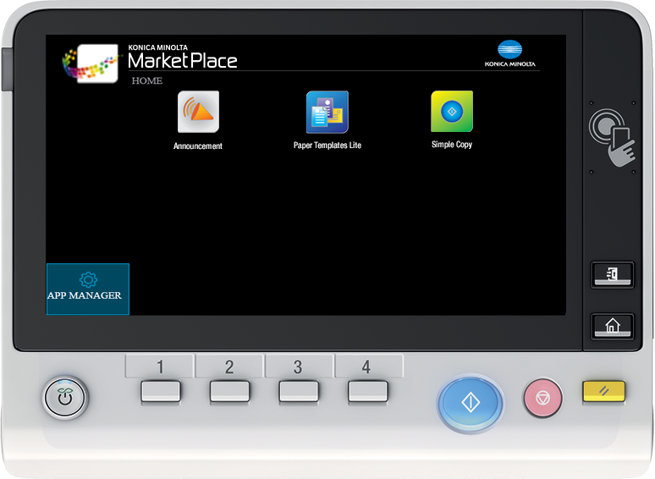
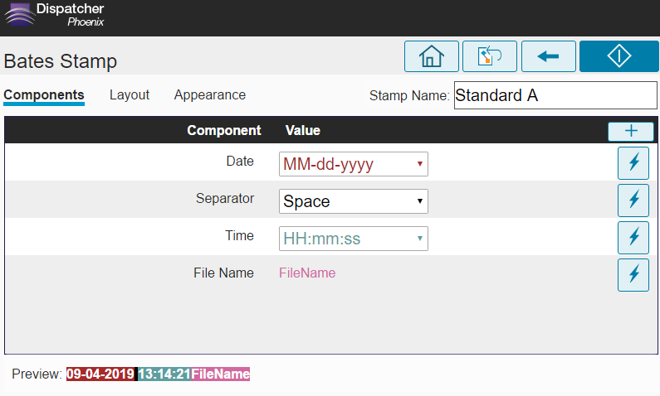
Automated Document Processes
Streamline document processing and reduce time spent on repetitive tasks with Dispatcher Phoenix’s powerful library of process nodes, including:
Advanced Bates Stamp
Advanced OCR
Annotation
Barcode Writer
Convert to Office
Convert to PDF
File Rename
Highlight & Strikeout
ODBC connector
Redact
Watermark
Many more…

Slide 12
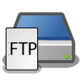
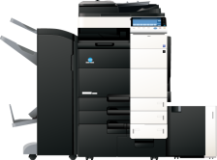
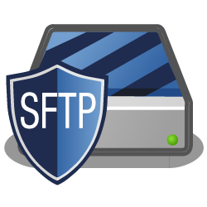
Improve Efficiencies with Intuitive Indexing
Expedite document distribution by automating workflow output of processed files. Popular distribution options include:
Email
Folder on the network or Desktop
FTP Server
Guardian by LawLogix
Laserfiche
OnBase by Hyland
Printer
Production Print Systems
SFTP Server
Windows Fax
Workshare
And More…

Slide 13
Share Documents to Drive Collaboration
Send processed documents to major cloud storage systems with ease.
Simple-to-use cloud connectors incorporate single sign-on to the cloud, so only one login is required!

Slide 14
Powerful Scalability
Create unique, modular cost-effective solutions tailored to changing financial needs with Dispatcher Phoenix’s enhanced scalability. Optional add-in modules include:
2D Barcode Processing
Advanced OCR
Barcode Processing
Batch Indexing
Copy Defender
Forms Processing
Release2Me for secure print release
Specialized connectors
Much more…

Slide 15
Finance-Specific Use Cases

Slide 16
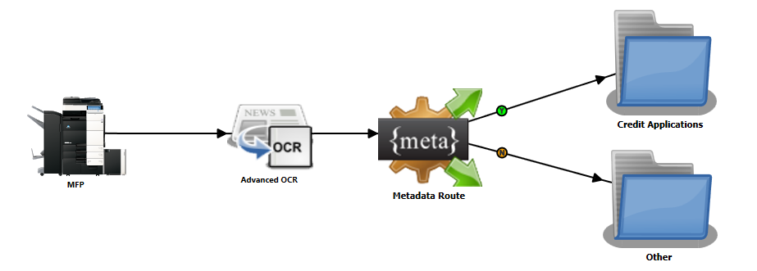
Route Financial Documents
Automatically separate credit applications from other scanned documents with the Advanced OCR and Metadata Route nodes. Other benefits include:
Virtually eliminating manually document handling costs
Reducing the number of document handling errors
Expediting application processing for the institution – and the customer

Slide 17
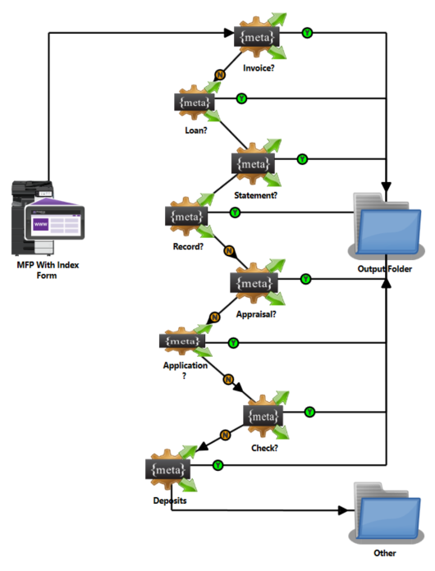
Scan and Route Documents – In a Single Step!
A small bank is growing quickly and needs to improve their document processes. A simple Dispatcher Phoenix workflow allows for:
Automatic routing of documents based on user input at the MFP
A significant reduction in processing time of unknown documents
Rather than worry about where to file something, the user can route unknown documents to an “Other” folder for further processing
Direct Connectors to 3rd party document management systems include:
Guardian
Laserfiche
OnBase
Worldox
Workshare
And more!

Slide 18
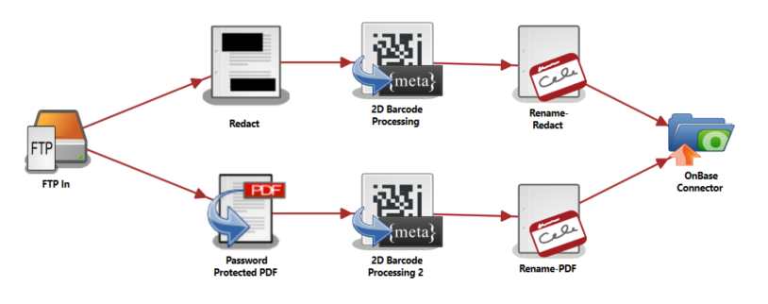
Secure Credit Application
A financial services firm needs to keep a protected version of documents for their records and remove identifying client information for document processing. Dispatcher Phoenix accomplishes this by:
Automatically creating two copies: one password-protected and one with customer information redacted
Extracting barcode data via advanced OCR
Renaming both documents based on the extracted barcode data for identification purposes
Automatically uploading documents to OnBase for further processing

Slide 19
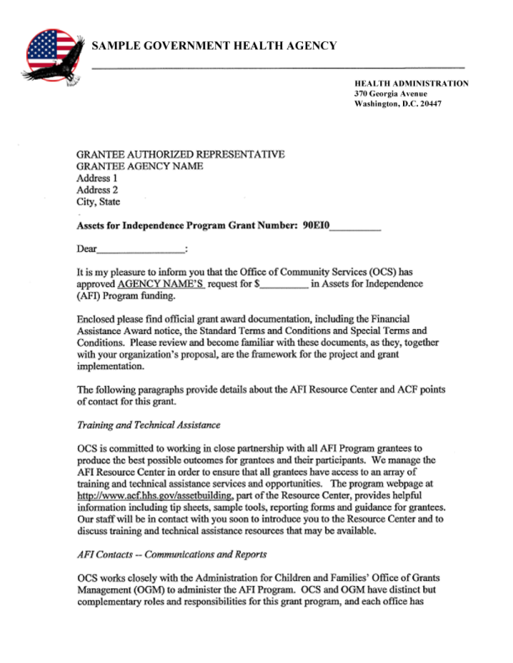
Respond To Privacy Regulations with Automatic Redaction
Eliminate the need for manual redaction operations using pen or mark-up tape! Dispatcher Phoenix includes Highlight, Strikeout, and Redaction capabilities, which allow you to:
Quickly search a document and highlight, strikeout, or redact sensitive information by searching for text or patterns like SSNs, phone numbers, addresses, etc.
Customize, create or remove document search terms directly at the MFP
Permanently remove information from financial documents including loan applications, tax documents, insurance claims, and more

Slide 20
Licensing

Slide 21
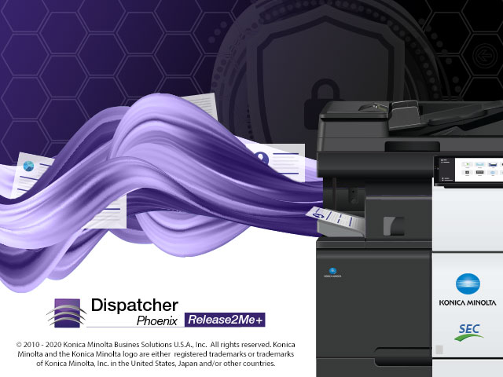
A Powerful Family of Solutions
Licenses
Dispatcher Phoenix – Award-winning flagship product for advanced workflow automation
Release2Me+ – Cost-effective, secure print release solution PLUS scan-to-cloud with OCR workflows
ScanTrip – Easy-to-use yet powerful scan-to-cloud with OCR solution
Optional Vertical Packages for Dispatcher Phoenix
Finance
ECM
Education
Government
Healthcare
Legal
Office

Slide 22
Included with the Dispatcher Phoenix standard license…
Collection Nodes
DP Mobile
Dropbox In
FTP In
Google Cloud Print
Input Folder
LPR In
MFP Panel
MFP User Box
Web Capture
Processing Nodes
Advanced OCR
Annotate
Color Route
Convert to PDF
Convert to PS
Deskew
Despeckle
Insert
Merge
Metadata to File
Metadata Routing
Metadata Scripting
Mirror Image
Negative Image
ODBC
Page Count Route
Parse & Distribute
Parse & Insert
Parse & Replace
Parser
PDF Metadata Extraction
PJL Print Preferences
Print to File
Rename
Split
Watermark
Distribution Nodes
Box Connector
Dropbox Connector
FilesAnywhere Connector
FileAssist Connector
FTP Out
Google Drive Connector
Microsoft Exchange Connector
OneDrive Connector
OneDrive for Business Connector
Output Folder
Printer
SFTP Out
SharePoint Connector
SharePoint Online Connector
SMTP Out
WebDAV Connector

Slide 23
Dispatcher Phoenix’s Finance Package
Easily capture, process, organize, and store important financial documents in the content management systems you’re already using.
This optional package provides the advanced document capture, processing and routing capabilities that document-intensive financial institutions need to drive productivity.
Finance Package Features
Barcode Processing (1D) w/ OmniPage
Barcode Processing (2D) w/ OmniPage
Convert to Office w/ OmniPage
OmniPage License for Advanced OCR
OmniPage License for Convert to PDF
Redaction/Highlight w/ OmniPage

Slide 24
Resources

Slide 25
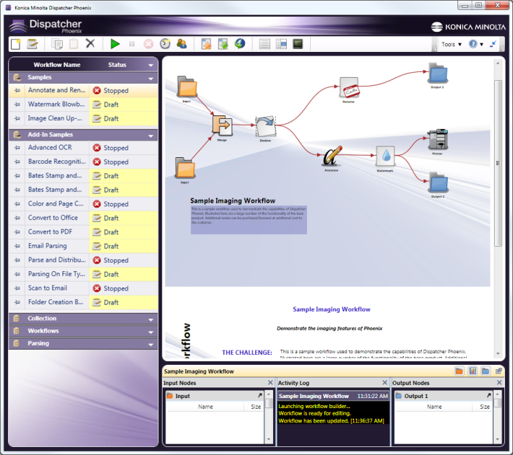
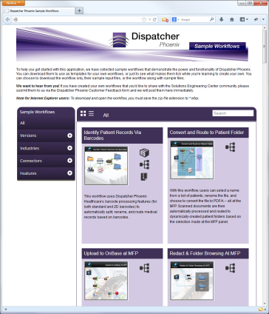
Get Started Quickly
Dispatcher Phoenix comes with a library of pre-configured workflows and templates, which can help you start using the product to its maximum potential quickly and easily.
Fully-configured sample workflow templates include:
Description of use case (challenge, solution, benefits)
Sample input files
Examples of fully-configured Finance workflows include:
Route Financial Documents with OCR
Route to Microsoft SharePoint
Redact and Highlight
Scan Financial Records
Secure Files
Split Credit Application
And more!
Easy-to-learn and perfect for first-time users!

Slide 26
Resources Available to You
Demo Licenses
Fully-functional 30-day demo licenses of Dispatcher Phoenix
Download today from sec.kmbs.us
Marketing Collateral
Brochures for Finance and other vertical markets
Battle Cards
Instructive and sales-based videos
MFP Simulators
Web-based and Instructor-led training
Download today from MyKonicaMinolta.com
Other Resources
NFR Licenses for Demo Rooms: sec.kmbs.us/nfr
Online help: docs.dispatcher-phoenix.com/
Comprehensive online documentation & solution walk-through
Intuitive, autocomplete search capabilities

Slide 27
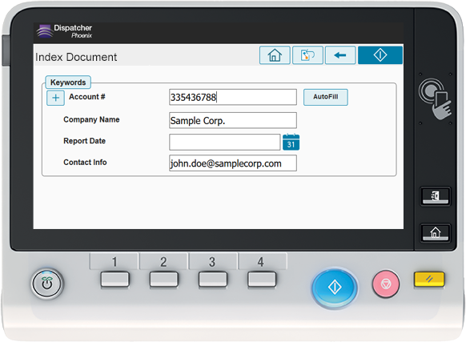
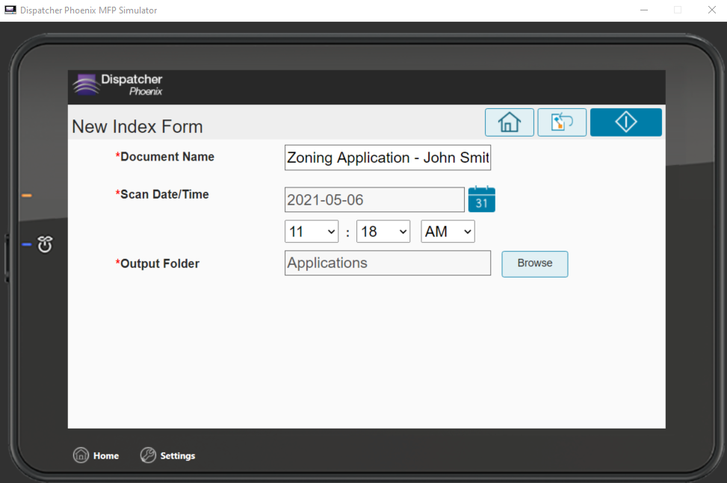
MFP Simulator
The Dispatcher Phoenix MFP Simulator gives you a view of the application’s “look and feel” on the MFP and does not require Dispatcher Phoenix or a physical MFP. It is currently available as:
A stand-alone, PC-based Simulator
An online, web-based Simulator that can be used on PC browsers, iPhones, iPads, Android devices, and other mobile devices
An integrated Simulator within Dispatcher Phoenix for testing workflows
Experience the power of Dispatcher Phoenix!

Slide 28
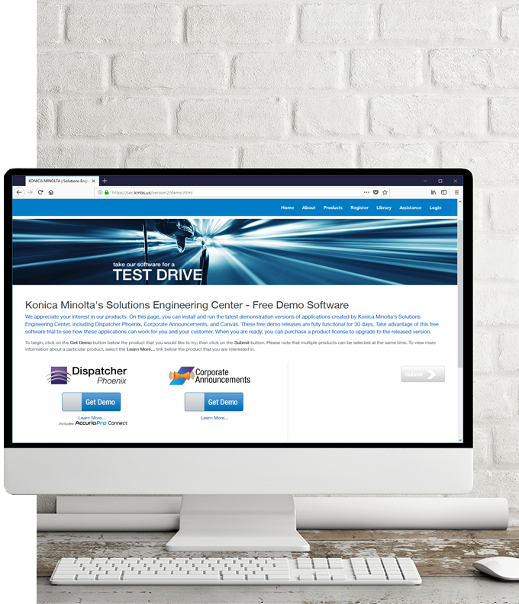
Helping You and Your Customers
SEC PRESALES SUPPORT
Review of customer requirements
Participate in discovery calls
Create Proofs of Concept for customer demos
Conduct demos of Dispatcher Phoenix features and functions
SEC POST-SALES SUPPORT
Professional Services
Remote Installation Services
Requires Business Needs Analysis

Slide 29
Thank You
sec@kmbs.konicaminolta.us

