Slide 1
Dispatcher Phoenix Healthcare
shape

Slide 2
Dispatcher Phoenix Is…
A family of workflow automation products developed by Konica Minolta
Easy-to-use solutions for assisting with Business Process Automation
Scalable with optional add-in modules

Slide 3
What It Does
Customized workflows collect, process, and distribute files
Workflows can be scheduled to run, or
Workflows can run on demand with the touch of a button on the MFP
Simple to Use, Economical and Powerful

Slide 4
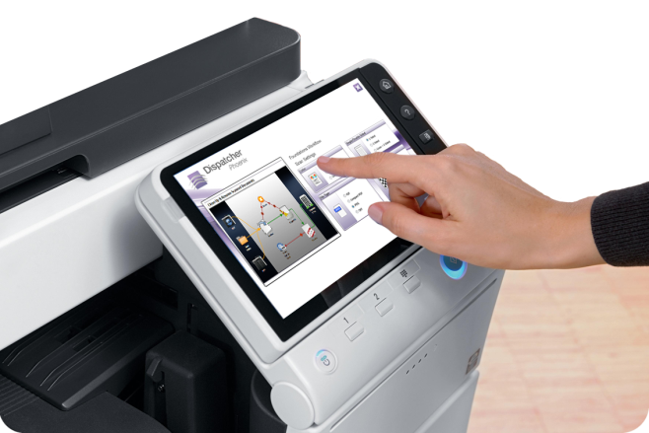
Working Smarter…
Automates redundant processes
Streamlines workflows
Simple and convenient
Graphical and intuitive MFP interface
Advanced functionality made simple
So simple, yet powerful. A Game changer to promote innovation

Slide 5
How It Works…
Collect files from a variety of sources (including mobile device!) process them based on the needs of your organization, and distribute the processed documents -- all automatically!

Slide 6
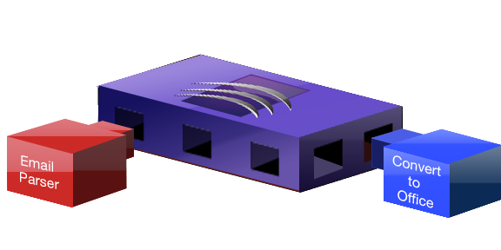
Add Features As Your Needs Change
Optional add-in modules include:
Bubble Grader
Forms Processing with Pattern Matching
Release2Me
Convert to Microsoft Office
Barcode Processing
Workshare Connector
Worldox Connector
Much more…
KDK Code
Generator
Email Parser
Barcode
Processing
Advanced OCR
2D Barcode
Processing
KDK-PDL
Converter
Forms Processing
Convert to
Office
OnBase Connector
Worldox Connector

Slide 7
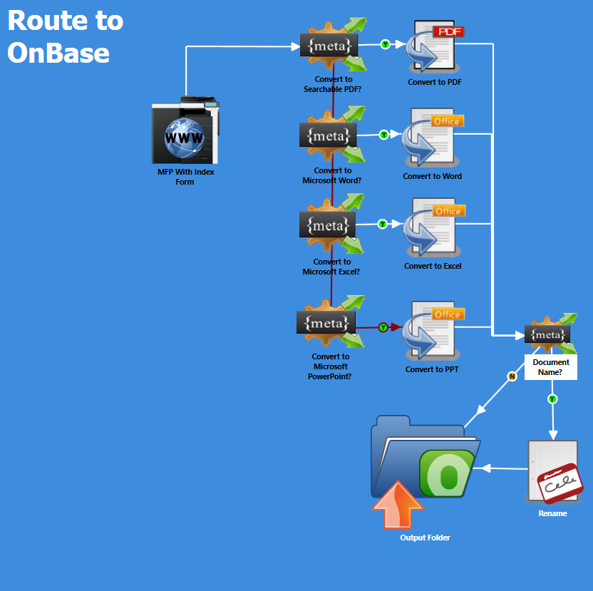
Specifically designed for healthcare organizations, includes:
OnBase Connector
Convert to PDF and Microsoft Office
Intelligent redaction
Rx Shield for secure prescriptions

Slide 8
Rx Shield
Dispatcher Phoenix’s Secure Prescription Print solution
To comply with tamper-resistant prescription policies from the Centers for Medicare & Medicaid Services (CMS).
Automates the process of printing CMS-compliant prescriptions on plain paper
No locking trays or special paper required
Bundled with Dispatcher Phoenix Healthcare edition

Slide 9
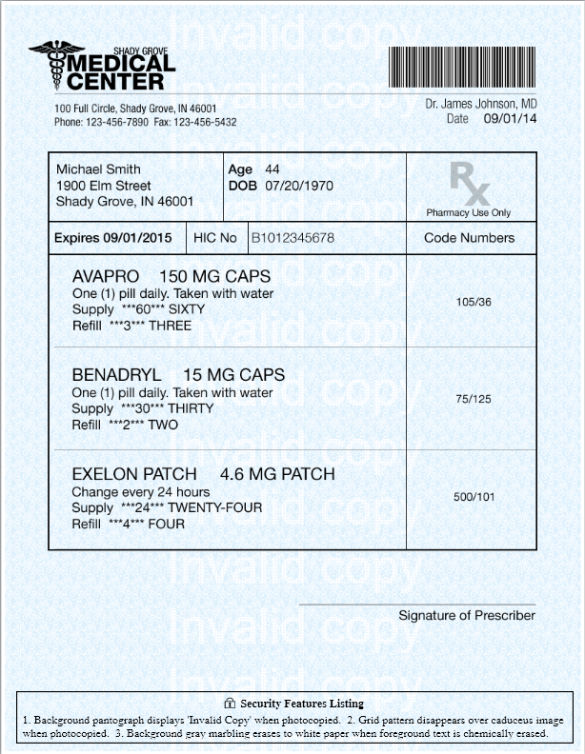
Rx Shield
Adds a pantograph background to the prescription that reveals words (“Invalid Copy,” “Copy,” “Invalid,” “Illegal Copy,” etc.) when the prescription is copied.
Adds a security warning box to the bottom of the page, which states the security features visible on the page.

Slide 10
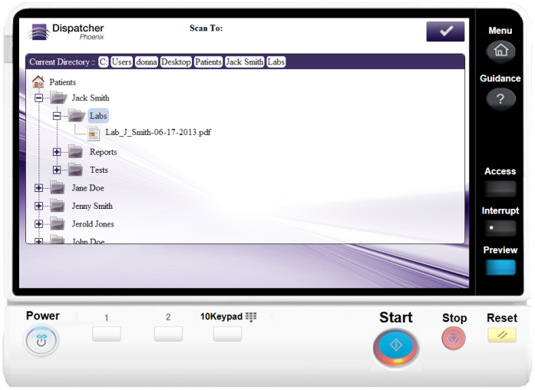
Use Case Scan, Index, and Distribute Patient Records
Folder Browsing - Browse through a Windows Explorer-like view of PC folder structure to find patient’s folder – directly at the MFP
OnBase Connector - Scan, index, and upload charts, lab reports, claims, etc. into OnBase by Hyland Software OnBase is a critical enterprise content management system product used within healthcare market (particularly with many Epic EHR users)

Slide 11
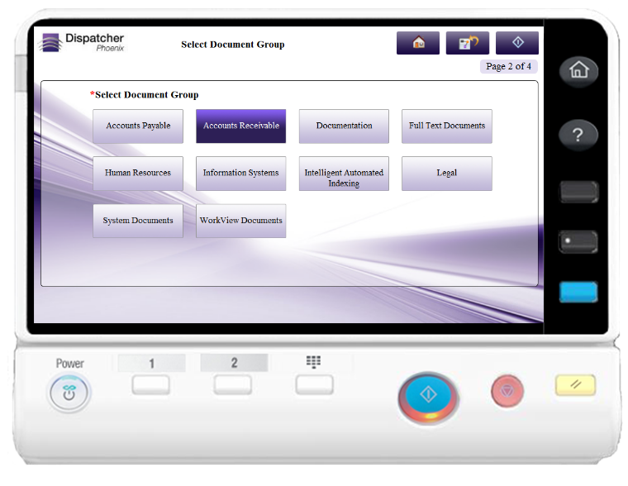
More About the OnBase Connector
Keyword Assignment
Pre-Scan Keyword Validation
Distribute to Document Types and Scan-Queues
Navigate Groups, Types, and Scan-Queues

Slide 12
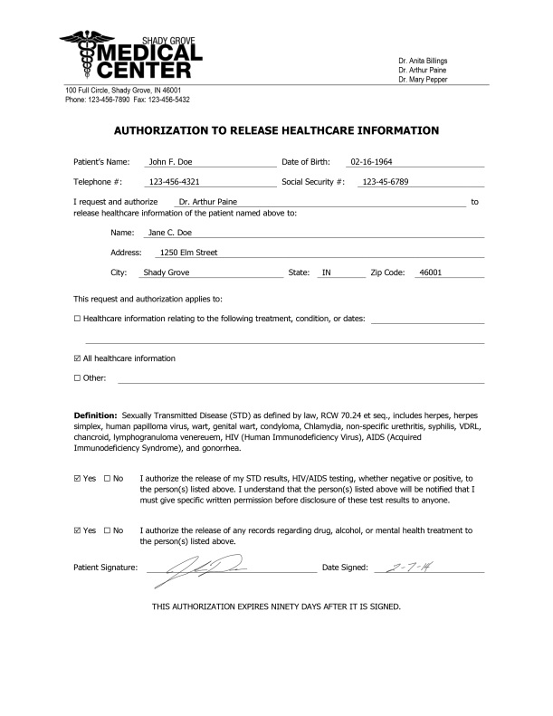
Use Case Protect Patient Information & Maintain Security Standards
Find and redact PHI (Protected Health Information) from documents such as explanation of benefits (EOBs), claims forms, etc. using intelligent redaction technology
Convert records to password-protected PDFs
Support for HID authentication and audit trails

Slide 13
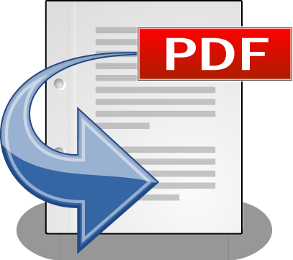
Use Case Access Medical Records Quickly
Automatically convert clinical notes, lab reports, medical claims, etc. to a variety of PDF and Microsoft Office formats
Supported PDF formats include PDF Searchable for keyword searching and PDF/A for long-term archiving

Slide 14
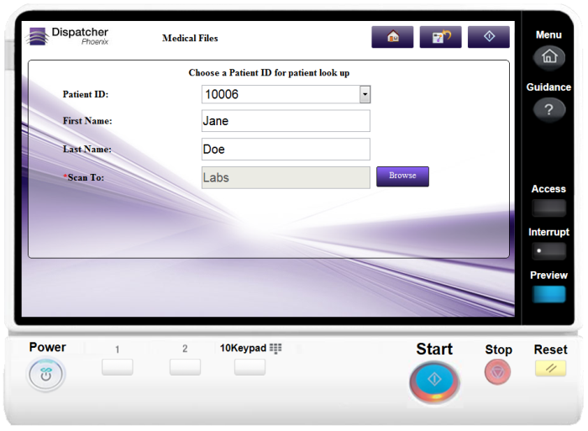
Use Case Look Up Patient Information at the MFP
Access patient information directly from MFP to process/index records
Pull information from ODBC-compliant databases for display on MFP control panel

Slide 15
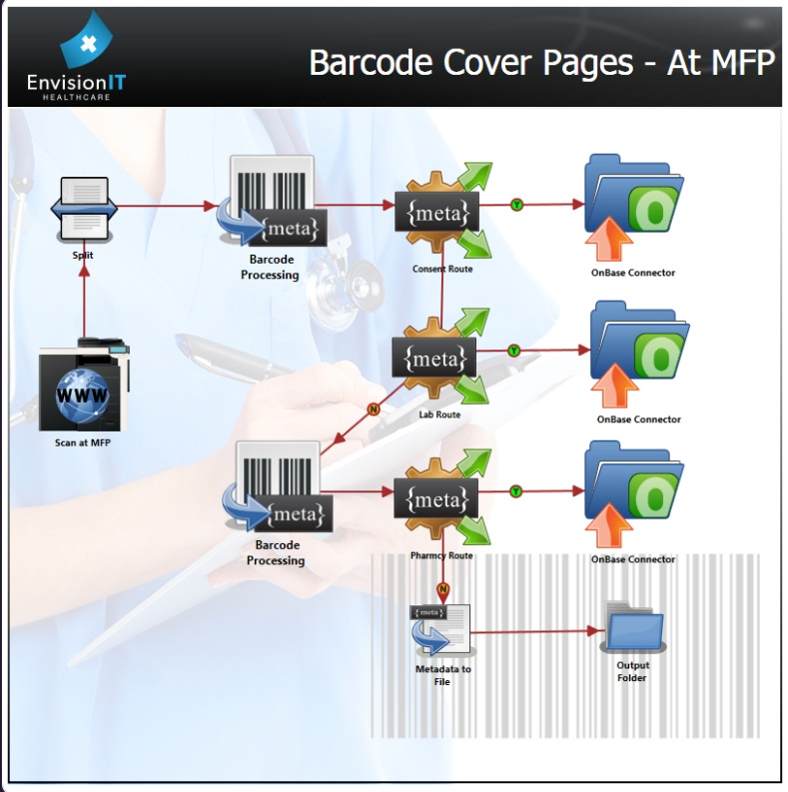
Use Case Identify Patient Records
Capture and process important patient health information
Automatically index, split, rename, and route medical records using barcodes

Slide 16
Use Case Extract Key Information From Records
Extract key information from patient and administrative records using zonal OCR
Eliminates the need for manual data entry in medical back-end systems

Slide 17
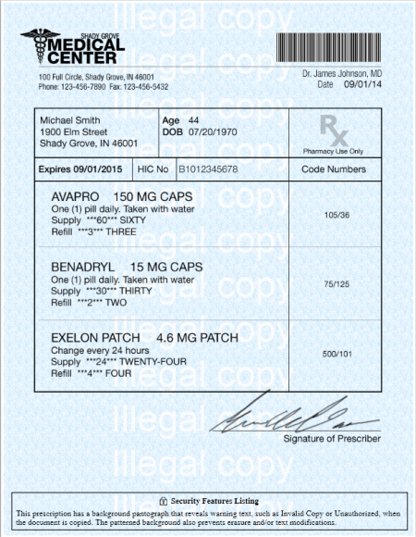
Use Case Rx Shield Secure Prescription Printing
Allows hospitals & clinics to comply with federal mandates for secure prescription print using plain paper
Adds a pantograph background to the prescription that reveals words (“Invalid Copy,” “Copy,” “Invalid,” “Illegal Copy,” etc.) when the prescription is copied.
Adds a security warning box to the bottom of the page, which states the security features visible on the page.
Eliminates the need for preprinted forms, secure locking trays

Slide 18
Thank You!

